Slide 1

Dutch Grammar Development
Joeri Honnef
Supervision: Anne Schiller
September 6th 2007

Slide 2
Contents
Introduction
XIP
  Disambiguation, Chunking, Dependencies
  Problems & Examples
Corpus
Evaluation
  Metrics, Objectives, Results & Error Analysis
Conclusion
Future directions

Slide 3
Example
FactSpotter© (ParSem’s NLP Tool) in the media.
“Wie vond de kopieermachine uit?”
“Who invented the copymachine?”
But what exactly enables FactSpotter© to do this?
Handcrafted Grammars within XIP©.

Slide 4
Goal & Motivation
Goal & Task
  Construct a dependency grammar for Dutch & wide coverage shallow processing of raw text (e.g. newspapers)
Motivation
  Pocket Engineer (7 languages)

Slide 5
Modular design of XIP
input
lexical lookup
POS disambiguation
chunking
dependencies
output

Slide 6
Problems and Examples
Lexical ambiguities (‘veel’ ):
  ‘ veel[quant] positieve reacties’
  ‘Ik veel[verb] niets.’
Chunking: sub clause detection (‘door’).
  ‘… door[conj] de politie rechtstreeks te benaderen.’
  ‘… door[prep] het raam’
Dependencies: objects vs. temporal expressions
  ‘Ik lees dit boek.’
  ‘Ik slaap deze week.’
(‘many positive reactions’)
(‘I detest nothing’)
(‘by approaching the police’)
(‘through the window’)
(‘I am reading this book’)
(‘I sleep this week’)

Slide 7

Disambiguation
Noun or
Adjective
Ambiguity:
Disambiguation
  Select correct reading from an ambiguity class
  Left context & right context
Possible rule:
adj, noun = adj | noun[noambiguity] | .

Slide 8
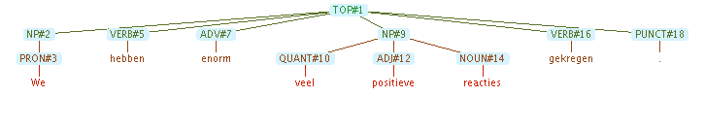
Chunking
Chunk: Sequence of one or more categories.
Rule example:
Output according rule:
np = quant, adj*, noun.

Slide 9
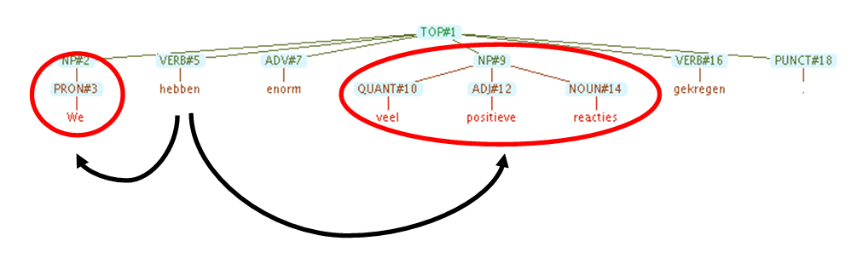
Dependencies
Finding dependency relations such as Subject-Object
Example rule:
|TOP{NP#1, verb#2[fin], ?*, NP#3}|
if(~SUBJ(#5, #6) & ~OBJ(#7, #8) )
SUBJ(#2, #1), OBJ(#2, #3).

Slide 10
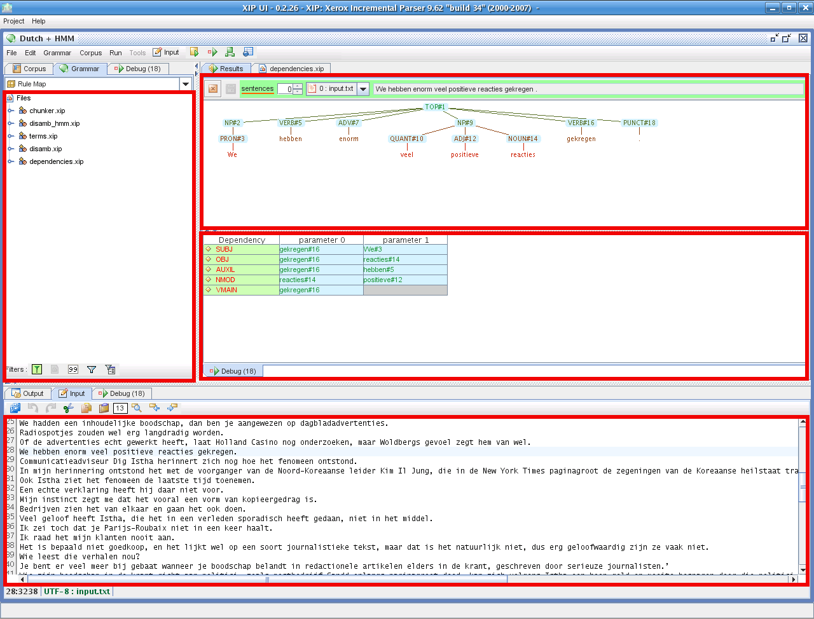

Slide 11
Corpus
3 categories from Volkskrant newspaper (economy, foreign, sports)
Semi hand-annotated (postags, chunks, dependencies)
137 sentences annotated, 332 Development

Slide 12
Evaluation
Main objectives
  Chunks (noun phrases, prepositional phrases)
  Dependencies (subject object)
Metrics:
  Precision, recall
  No partial analysis

Slide 13
Results
Foreign (67) Dev. + Test Set | Precision | Recall
Noun Phrases | 99.2 | 98.9
Prep. Phrases | 99.3 | 100
Subjects | 85.7 | 80.0
Objects | 82.4 | 64.6

Slide 14
Results
before
refinement
after
Economy 70 | Precision | Recall
Noun Phrases | 95.5 | 97.2
Prep. Phrases | 97.4 | 98.3
Subjects | 86.8 | 51.9
Objects | 51.1 | 38.1
Economy 70 | Precision | Recall
Noun Phrases | 95.4 | 95.7
Prep. Phrases | 96.6 | 98.3
Subjects | 83.8 | 86.1
Objects | 73.8 | 75

Slide 15
Preliminary Error analysis
Sub-clause boundary detection errors
Coordinating conjunctions in long sentences.
  Objects get attached to wrong verb
Wrong NP’s result in wrong subjects and objects
Wrong NP’s are often caused by wrong POS tags.

Slide 16
Contributions
Refinement of morphology issues
Disambiguation rules
Chunking rules
Dependency rules
Interface Nutch search engine

Slide 17
Conclusion
General:
  Implementation of a basic, general grammar for Dutch
  Similar linguistic phenomena as in German and English
  Specific applications will need more tailoring
Personal:
  Learned a lot about the syntactic structures of Dutch
  Tradeoff between very general rules vs. specific rules
Notes:
The XIP environment allows for a very fast and flexible approach of Natural Language Processing. Very specific but also very general rules can be written but the grammar writer should always carefully make the tradeoff between them.
more refinement work to be reliable for future incoming raw text.

Slide 18
Future directions
Dutch grammar
  Testing & improving on larger corpora.
  Extensions: Named Entities
General
  Investigate combination of statistical and symbolic analysis.

Slide 19
Questions?

